Slide 1
2020-02-28
UKTAG Meeting #3
NI TestStand Plug-Ins
Michał Bieńkowski

Slide 2
Agenda
Test System Overview
Process Model
Plug-ins and Add-ons
Result Processing
Result Collection
OTFR
ORPU

Slide 3

Test System Overview
Notes:
Photo by Louis Reed on Unsplash

Slide 4
Test System Overview
Execution Control
Branching
Drivers
Tests
Code Modules
Sequences
Localization
SPC
Operator Interface
Data Acquisition
Documentation
Files Management
Looping
Sequence Editor
Reports
Test Code
Test Limits
Results Collection
Utilities
Synchronization
Machine Control
Measurements
Variables Management
Deployment
SCC
Configuration
Results Analysis
Test Status Visualization
UUT Tracking
Customization
Process Control
Limits Evaluation
Parallel Testing
Database Logging
Results Processing
Calibration
User Management
MES
Other?
Offline Results Processing

Slide 5
Test System Overview
Execution Control
Branching
Drivers
Tests
Code Modules
Sequences
Localization
SPC
Operator Interface
Data Acquisition
Documentation
Files Management
Looping
Sequence Editor
Reports
Test Code
Test Limits
Results Collection
Utilities
Synchronization
Machine Control
Measurements
Variables Management
Deployment
SCC
Configuration
Results Analysis
Test Status Visualization
UUT Tracking
Customization
Process Control
Limits Evaluation
Parallel Testing
Database Logging
Results Processing
Calibration
User Management
MES
Other?
Offline Results Processing
Product Specific?

Slide 6
Test System Overview
Execution Control
Branching
Drivers
Non-Product Specific
Localization
SPC
Operator Interface
Files Management
Looping
Sequence Editor
Results Collection
Utilities
Synchronization
Variables Management
Deployment
SCC
Test Status Visualization
UUT Tracking
Customization
Process Control
Limits Evaluation
Parallel Testing
Database Logging
Results Processing
Calibration
User Management
MES
Other?
Offline Results Processing

Slide 7
Test System Overview
Execution Control
Branching
Drivers
Non-Product Specific
Localization
SPC
Operator Interface
Engine
Files Management
Looping
Sequence Editor
Framework
Results Collection
Utilities
Synchronization
Variables Management
Deployment
SCC
Test Status Visualization
UUT Tracking
Customization
Process Control
Limits Evaluation
Parallel Testing
Database Logging
Results Processing
Calibration
User Management
MES
Other?
Offline Results Processing

Slide 8
Test System Overview
Execution Control
Branching
Drivers
Non-Product Specific
Localization
SPC
Operator Interface
Engine
Files Management
Looping
Sequence Editor
Framework
Results Collection
Utilities
Synchronization
Process Model
Variables Management
Deployment
SCC
Test Status Visualization
UUT Tracking
Customization
Process Control
Limits Evaluation
Parallel Testing
Database Logging
Results Processing
Calibration
User Management
MES
Other?
Offline Results Processing

Slide 9
Test System Overview
Process Model
Plug-Ins and Add-ons
Result Processing
Test Status Visualization
UUT Tracking
Customization
Process Control
Limits Evaluation
Parallel Testing
Database Logging
Results Processing
Calibration
User Management
MES
Other?
Offline Results Processing

Slide 10

Process Model
Notes:
Photo by Bill Oxford on Unsplash

Slide 11
Process Model
: Example
Loop
Socket
Trace Log
Tests
Tests
Tests
Field Return
BIST
S/N
MES
Full Production-Run
Reporting
Cleanup
Full Production-Run
Full Production-Run
Field Return
Field Return
Different UUTs
Calibration
Notes:
Process Model is a set of operations and the flow of execution, common and usually constant operations.
The testing process can vary depending on the production line or company practices.

Slide 12

Process Model: Comparison
Sequential
Parallel
Batch
UUT
UUT
UUT
UUT
UUT
UUT
UUT
Socket #0
Socket #1
Socket #2
Socket #0
Socket #1
Socket #2
TESTING
TESTING
Results
Results
Results
Results
Results
Results
Results

Slide 13
Process Model: Example
Loop
Socket
Trace Log
Tests
Tests
Tests
Field Return
BIST
S/N
MES
Full Production-Run
Reporting
Cleanup
Full Production-Run
Full Production-Run
Field Return
Field Return
Different UUTs
Calibration

Slide 14
Process Model: Architecture Change
Monolithic and Plug-in Based Architectures
Monolithic till 2010
Plug-in based since 2012
Process Model
Process Model
ModelSupport.seq
Report Generator (HTML)
Database Logger (Access)
Plug-in Instance
Plug-in Instance
Plug-in Instance
Report Generator (HTML)
Report Generator (ATML)
Custom Plug-in
ReportGen_HTML.seq
Database.seq
Result Processing Code
Result Processing Code
Result Processing Code
ReportGen_HTML.seq
ReportGen_ATML.seq
MyResultProc.seq
Notes:
http://www.ni.com/tutorial/14204/en/

Slide 15
Process Model: Example
Loop
Socket
Trace Log
Tests
Tests
Tests
Field Return
BIST
S/N
MES
Full Production-Run
Reporting
Full Production-Run
Reporting
Cleanup
Full Production-Run
ASCII
Field Return
DB
OTF
Field Return
ORP
XML
Different UUTs
HTML
Calibration

Slide 16

Process Model: Single Threading
UUT
THREAD 1
TESTING
TESTING
TESTING
PROCESSING
PROCESSING
PROCESSING

Slide 17
Process Model: Multithreading
UUT
THREAD 1
TESTING
TESTING
TESTING
00110101101011
00110101101011
00110101101011
THREAD 2
PROCESSING
PROCESSING
PROCESSING

Slide 18
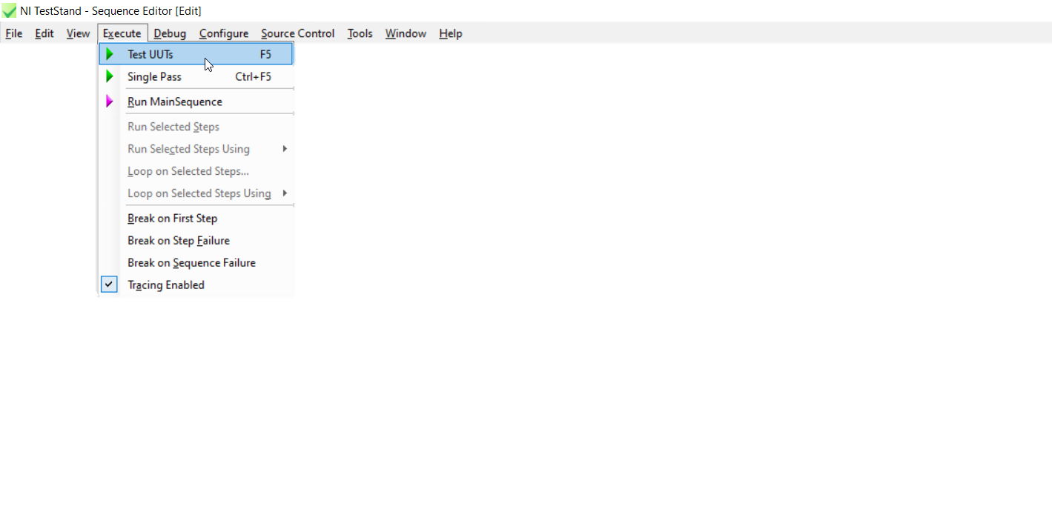
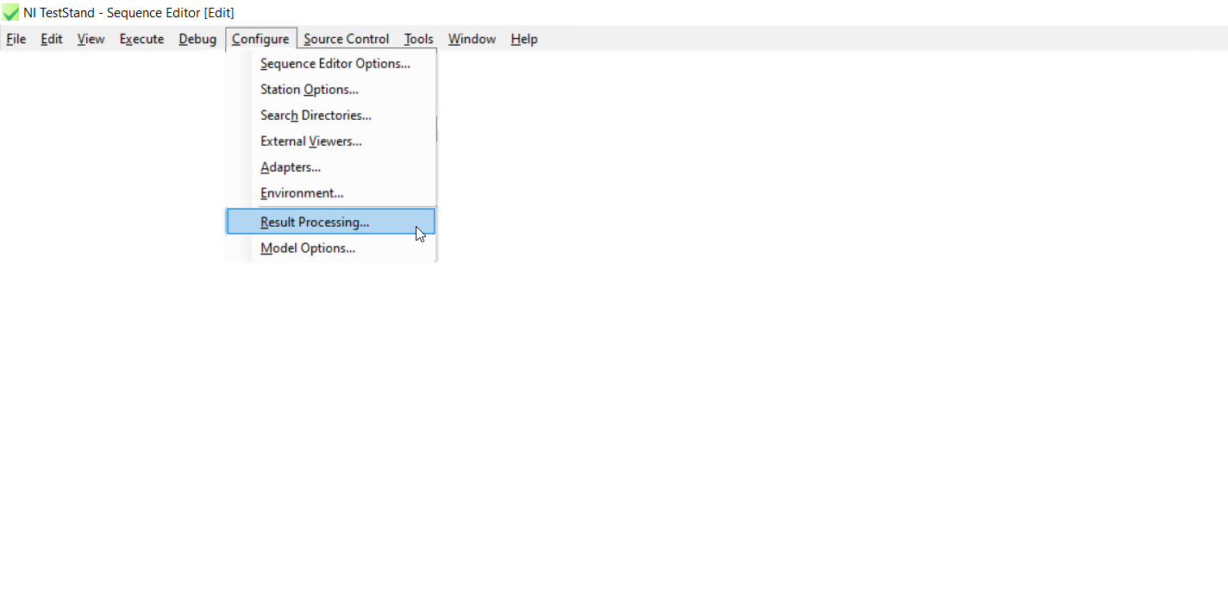

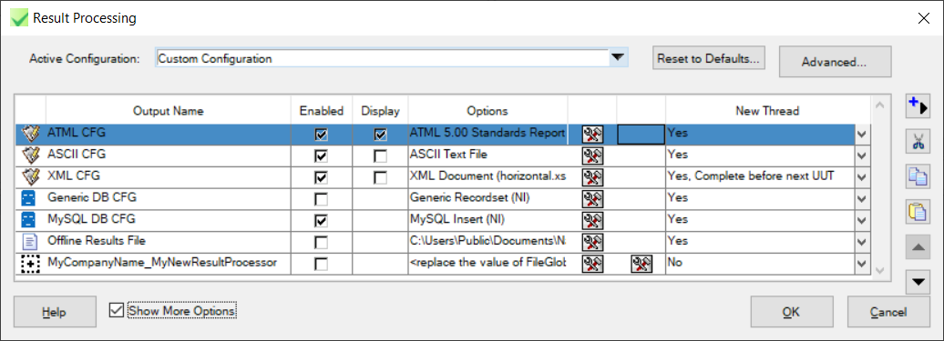



Process Model: Callbacks
ProcessSetup
ProcessCleanup
ModelOptions
DatabaseOptions
PreUUTLoop
PostUUTLoop
ModelPluginConfiguration
LogToDatabase
PreUUT
PostUUT
ModelPluginOptions
ReportOptions
PreMainSequence
PostMainSequence
TestReport
MainSequence
ModifyReportHeader
Configure Model Options
ModifyReportEntry
Configure Result Processing
ModifyReportFooter
Test UUTs
Single Pass
GetReportFilePath
ProcessModelPostResults

Slide 19
Process Model: Configure Result Processing
NI_ReportGenerator.seq → 3 instances
NI_DatabaseLogger.seq → 2 instances
NI_OfflineResultsGenerator.seq → 1 instance
MyCompanyName_MyNewResultProcessor.seq → 1 instance

Slide 20

Process Model: Step by Step
Test UUTs
Initialize Execution Entry Point
AddExtraResult
RunState.TestSockets and ModelData.TestSockets init
Client file check
StationInfo init
ModelOptions and Load Configuration for the plugins
To alter TestStandModelModelOptions.ini
To load ResultProcessing.cfg and Addons.cfg
ModelOptions
Load Configuration
MP - Begin

Slide 21

Process Model: Step by Step
Test UUTs
Initialize Execution Entry Point
Initialize Model Plugins
ModelOptions
Loop for each ModelPluginConfiguration.Plugins
ShallowCopyOfProcessorArray
Plug-ins cache
Load Configuration
Loop for each ShallowCopyOfProcessorArray
Initialize
ModelPluginOptions
MP - Begin
ModelPluginConfiguration
Loop for each ModelPluginConfiguration.Plugins
Plug-ins cache
Initialize
ModelPluginOptions
Loop for each ModelPluginConfiguration.RuntimeVariables.RunOrders.Begin
Begin

Slide 22
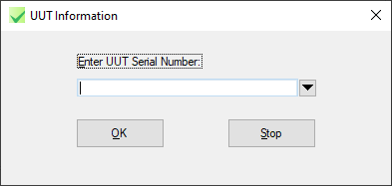
Process Model: Step by Step
Test UUTs
Initialize Execution Entry Point
PreUUT
DoPreUUT
MP - Begin
MP – Pre UUT
ProcessSetup
Loop for each RunOrders.PreUUT
Pre UUT
MP – UUT Start
PreUUTLoop
Loop for each RunOrders.UUTStart
UUT Start
Loop until ContinueTesting
PreMainSequence
MainSequence

Slide 23
Process Model: Step by Step
Test UUTs
Initialize Execution Entry Point
MainSequence
Loop for each RunOrders.UUTDone
If NewThread?
MP - Begin
PostMainSequence
Create CallerCanProceed notifier
ProcessSetup
MP – UUT Done
Call UUT Done/Batch Done From New Thread
PreUUTLoop
Call UUT Done/Batch Done
UUT Done
Loop until ContinueTesting
Resume thread
New thread Initially suspended
CompleteBeforeNextUUT?
Wait for the notfier from the plugin UUT Done, but be sure that the thread is still running
Else
UUT Done

Slide 24
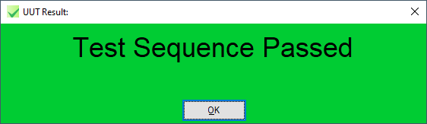
Process Model: Step by Step
Test UUTs
Initialize Execution Entry Point
MainSequence
MP - Begin
PostMainSequence
ProcessSetup
MP – UUT Done
PreUUTLoop
Call UUT Done/Batch Done
UUT Done
Loop until ContinueTesting
MP – Post UUT
Loop for each RunOrders.PostUUT
Post UUT
PostUUT
DoPostUUT

Slide 25
Process Model: Step by Step
Test UUTs
Initialize Execution Entry Point
MP - Begin
ProcessSetup
PreUUTLoop
Loop until ContinueTesting
MainSequence
PostUUTLoop
ProcessCleanup
MP - End
Loop for each RunOrders.End
End

Slide 26
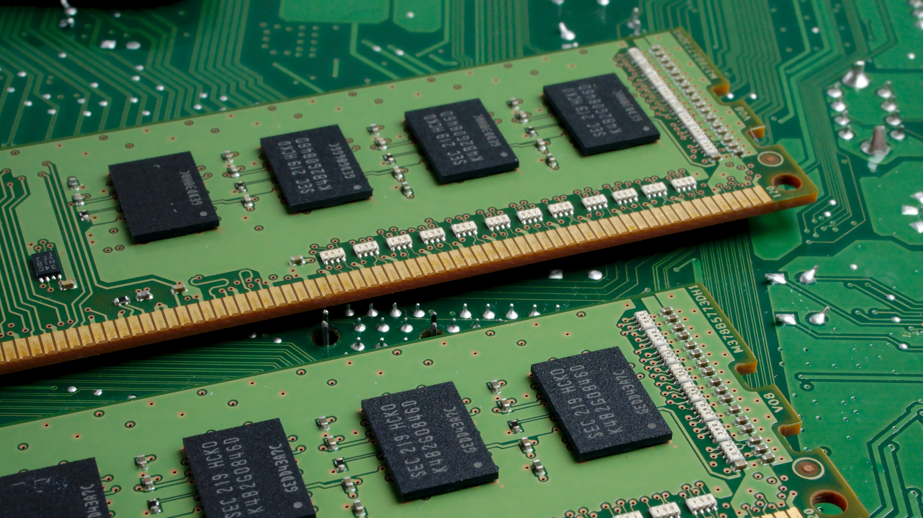
Plug-ins and Add-ons
Notes:
Photo by Michael Dziedzic on Unsplash

Slide 27
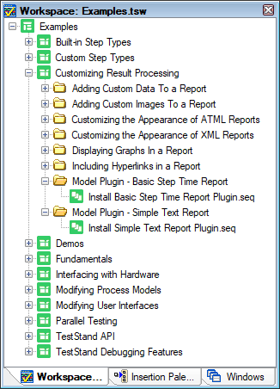
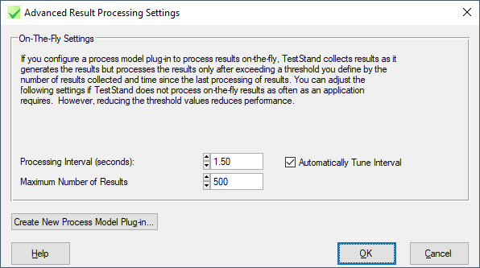
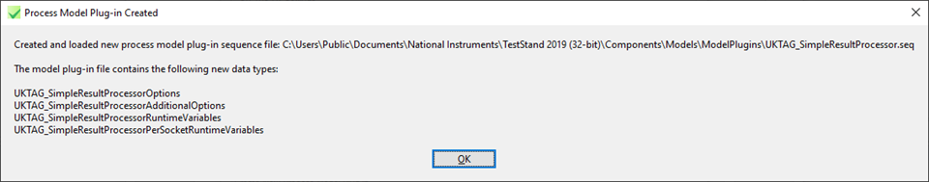
Plug-ins and Add-ons
: Where to Start?
Help >> Find Examples >>
<TestStand>
%teststand%\Components\Models\ModelPlugins
Configure >> Result Processing >> Show More Options >> Advanced

Slide 28
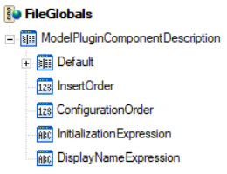
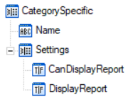
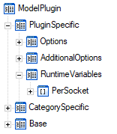
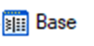
Plug-ins and Add-ons: Properties

Slide 29
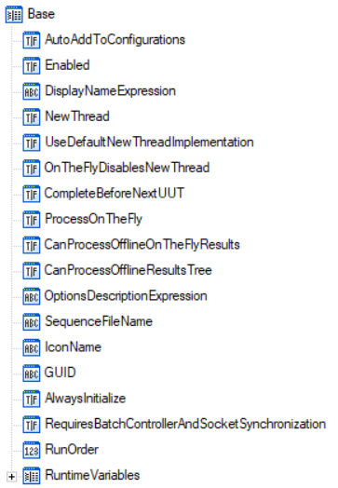

Plug-ins and Add-ons: Properties

Slide 30
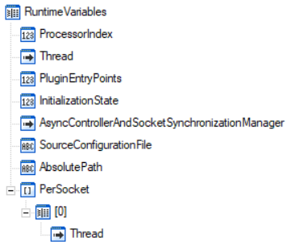
Plug-ins and Add-ons: Properties

Slide 31
Plug-ins and Add-ons: Plug-in Entry Points
<TestStand Public>
%teststandpublic%\Components\Models\ModelPlugins[\Addons]
Initialize
Batch Start
Batch Done
Begin
UUT Start
Post UUT
Pre Batch
OnTheFly
Step Results
Post Batch
Pre UUT
UUT Done
End
Configure
Standard Options
Configure Additional Options

Slide 32
Plug-ins and Add-ons: Simple Plug-in Example
UUT Start
UUT Done

Slide 33
Plug-ins and Add-ons: Report Class
Execution
Report
Reports
ActiveReport
Report

Slide 34
Plug-ins and Add-ons: Report Class
Append
ReportSection
Report.Append
Report.LatestAppendIndex
Report.GetSection
Report.NewReportSection
Report.ReportSection
ReportSubsections.Insert

Slide 35
Plug-ins and Add-ons: Report Class
ReportSubsection
ReportSection
ReportSection
ReportSection
Locals.ReportSection.AsReportSection.Body = "Report Text"
ReportSection
ReportSection
ReportSection
ReportSection
ReportSection
Header
Body
Footer
ReportSection
ReportSection
ReportSection
Locals.ReportSubSection = Locals.ReportSection.AsReportSection.ReportSubsections.Insert()
Locals.ReportSection = RunState.Execution.Report.NewReportSection()
RunState.Execution.Report.ReportSection = Locals.ReportSection
Notes:
Locals.ReportSection = RunState.Execution.Report.NewReportSection()
Locals.ReportSection.AsReportSection.Body = "Report Text"
Locals.ReportSubSection = Locals.ReportSection.AsReportSection.ReportSubsections.Insert()
RunState.Execution.Report.ReportSection = Locals.ReportSection

Slide 36
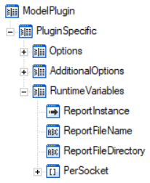
Plug-ins and Add-ons: Simple Plug-in Example
UUT Start
If ...DisplayReport && Locals.ReportInstance == Nothing Then
Locals.ReportInstance = …Reports.ActiveReport
...ReportInstance = ...Reports.Replace(Locals.ReportInstance, Nothing)
...ReportFileName = "Report_" + Parameters.UUT.SerialNumber + "_" +
Locals.ISO8601 + ".txt"
…ReportFileDirectory =
RunState.Engine.GetTestStandPath(TestStandPath_Temporary)
UUT Done

Slide 37
Plug-ins and Add-ons: Simple Plug-in Example
Locals.ReportInstance = ...ReportInstance,
Locals.ReportPath = ...ReportFileDirectory + "\\" + ...ReportFileName,
Locals.MainSeqResultList =
#NoValidation(Param...MainSequenceResult.TS.SequenceCall.ResultList)
Unblock Calling Thread
Locals.ReportSection = Locals.ReportInstance.AsRS.NewReportSection()
MainSeqResultList Traversal
Locals.ReportInstance.AsR.ReportSection = Locals.ReportSection,
Locals.ReportInstance.AsR.RefreshDisplay()
Locals.ReportInstance.AsR.Save(Locals.ReportPath)
UUT Start
UUT Done

Slide 38
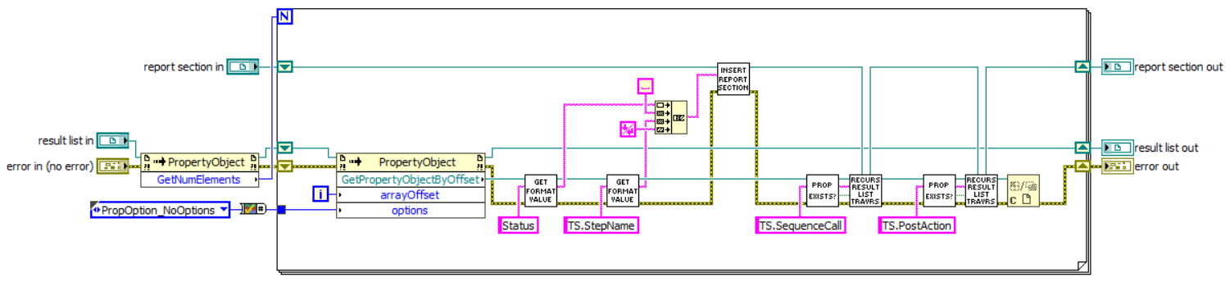
Plug-ins and Add-ons: Simple Plug-in Example
Insert interesting properties to the ReportSection
Loop for each result list item
Get interesting properties
Repeat recursively for Sequence Calls and PostActions
PropertyObject.Exists("lookup string", PropOption_NoOptions)
PropertyObject.GetPropertyObject("lookup string", PropOption_NoOptions)
PropertyObject.GetFormattedValue ("lookup string", PropOption_NoOptions, "", True, ",")
ReportSection.ReportSubsections.Insert(-1, "", „report text", "")

Slide 39
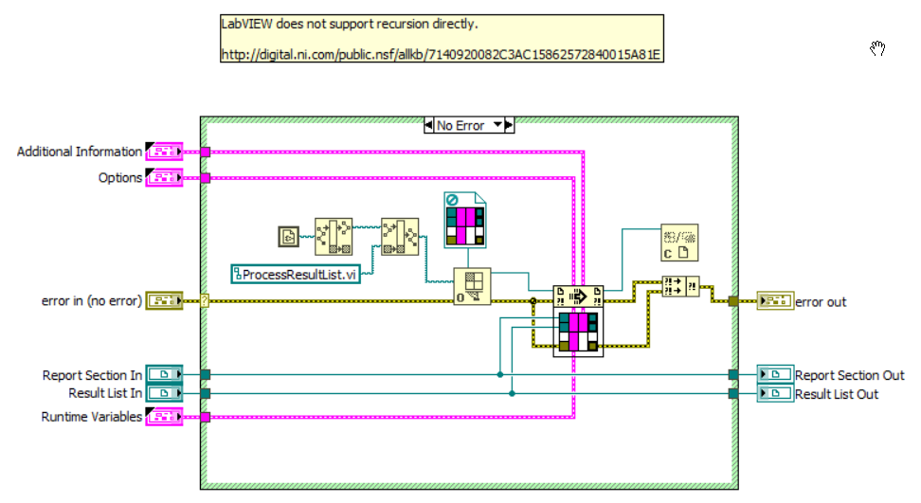
Plug-ins and Add-ons: Simple Plug-in Example
Is this still true?
From NI_SimpleTextReport_LabVIEW.seq

Slide 40
Plug-ins and Add-ons: Now your turn
Good Luck!

Slide 41
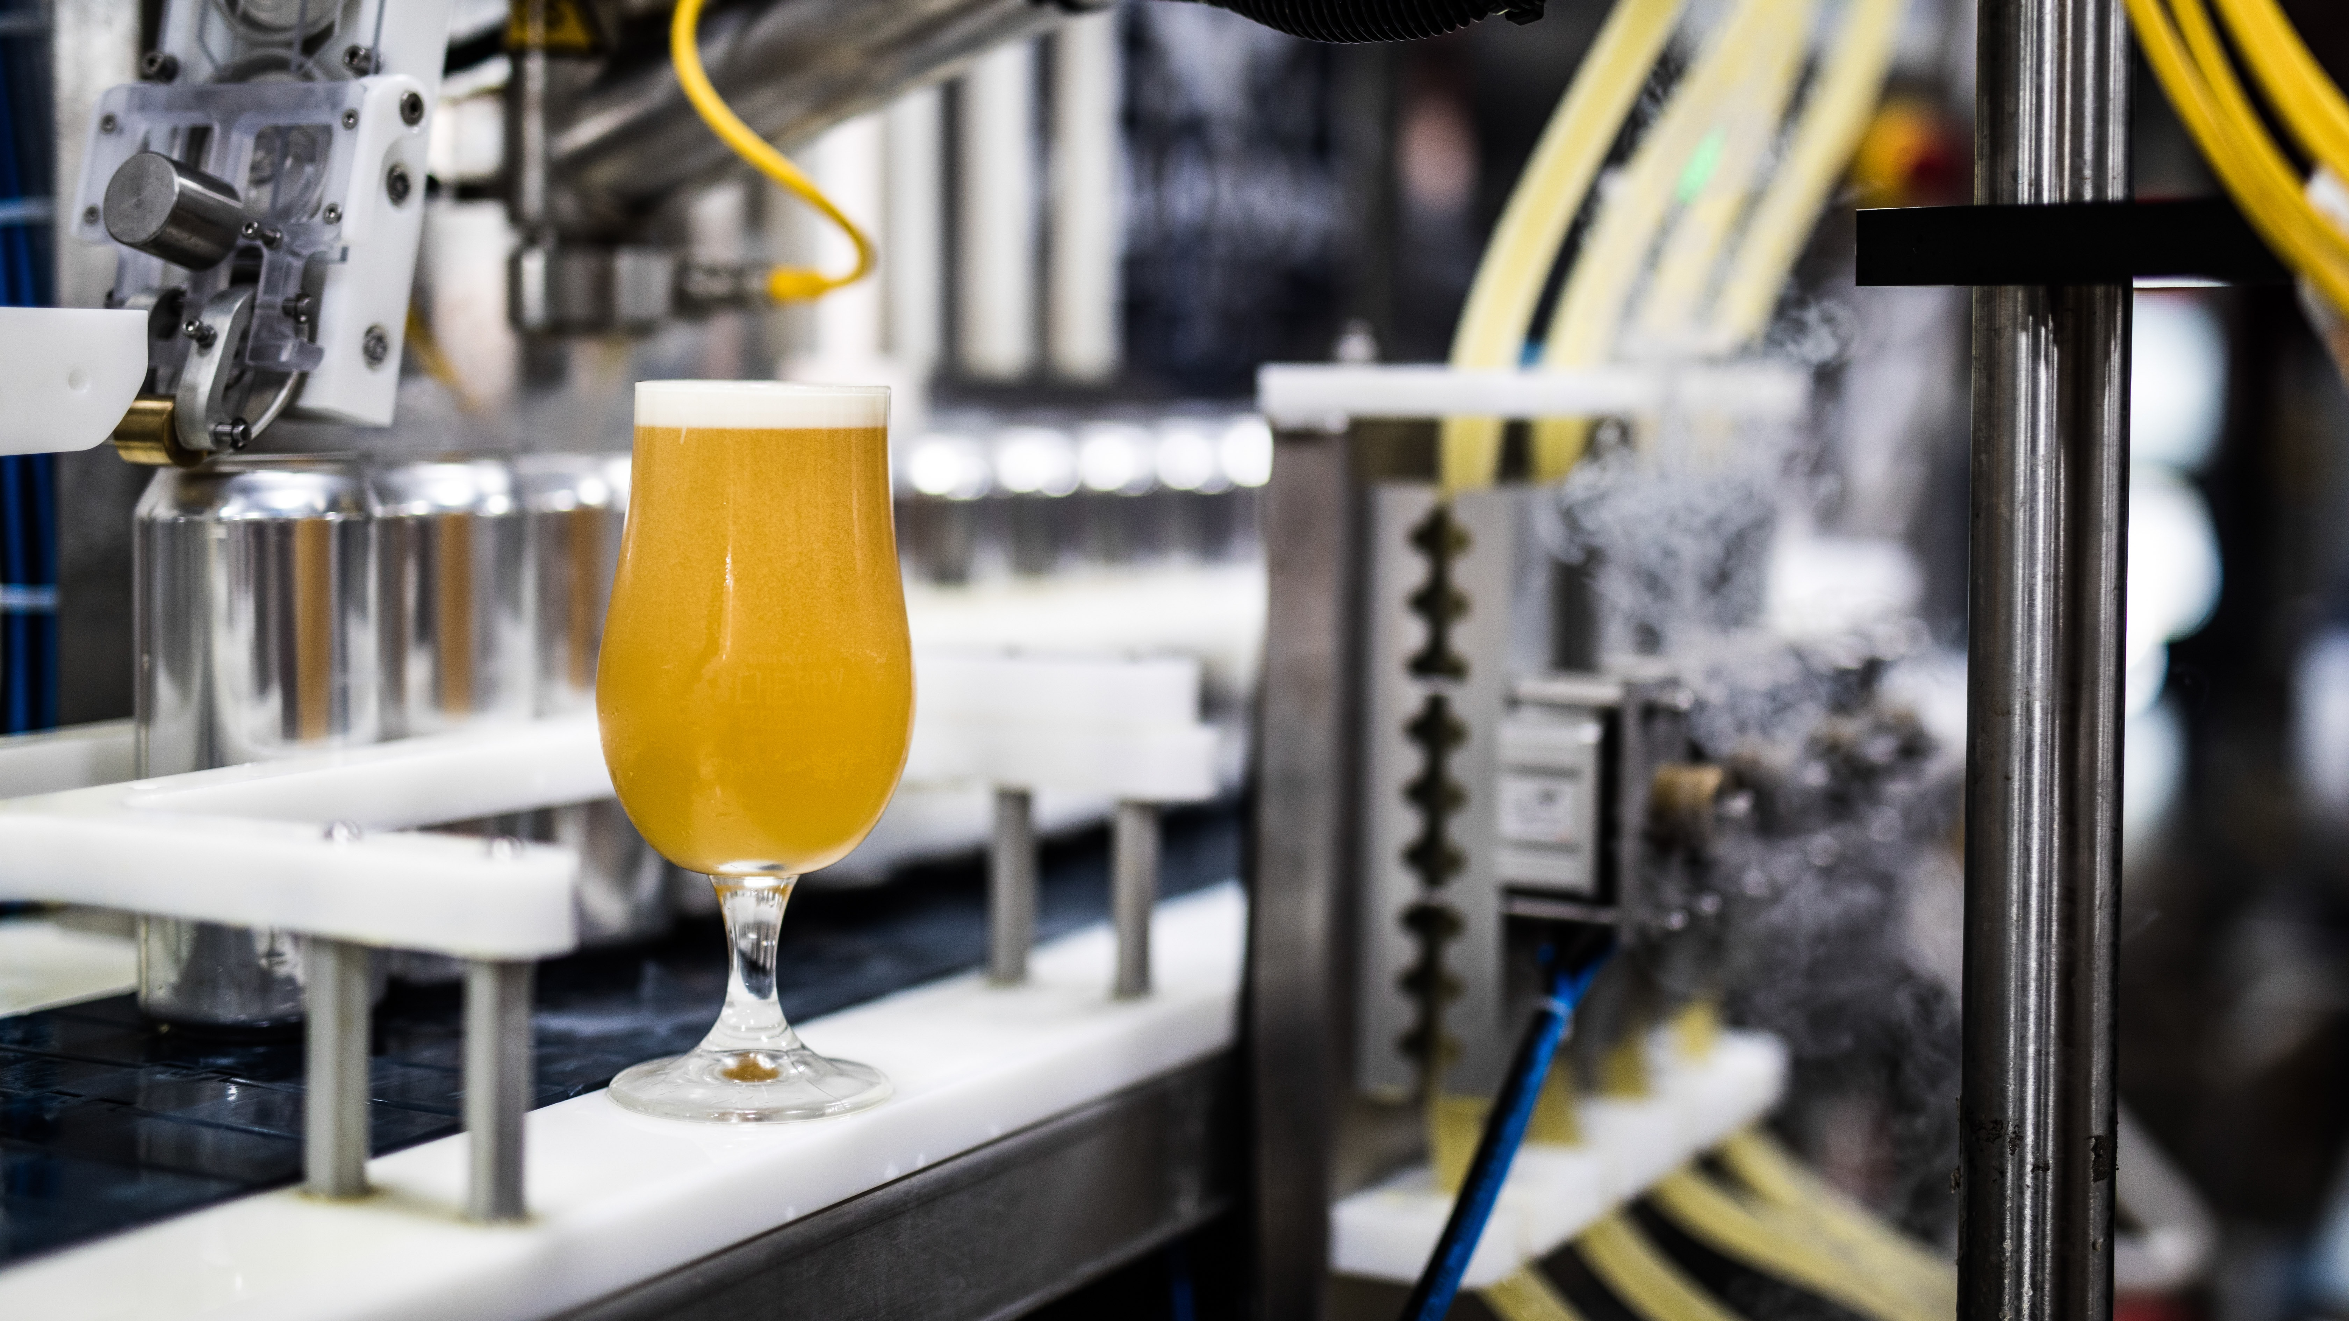
Thank you
All photos taken from Unsplash
Louis Reed
Bill Oxford
Michael Dziedzic
Evan Dvorkin
Michał Bieńkowski
CTA, CLA
Notes:
Photo by Evan Dvorkin on Unsplash

